Slide 1
Heart Failure
What are the causes of hearth failure and is there any signs to pick up from?

Slide 2
But Why Is This Important?
Cardiovascular diseases are the number 1 cause of death globally
It’s an estimated 17.9 million people’s lives (31% of deaths worldwide) are taken from this disease
If this can be prevented, then are we not doing something about it?

Slide 3
Previous Research
Research suggests the following factors are likely to contribute to heart failure:
Hypertension
Diabetes
Hyperlipidaemia
Tabacco use
Obesity

Slide 4
Let’s look further!

Slide 5
Brief on the Dataset
The inspected data was taken from the Kaggle website:
https://www.kaggle.com/andrewmvd/heart-failure-clinical-data
Features Include:
Age
Anamia(Decrease of red blood cells)
Creatine Phosphokinase
Diabetic
Ejection Fraction(Percent of blood leaving the heart with each contraction)
High Blood Pressure
Platelets
Serum Creatinine
Serum Sodium
Sex
Smoked
Time(Follow up period)

Slide 6
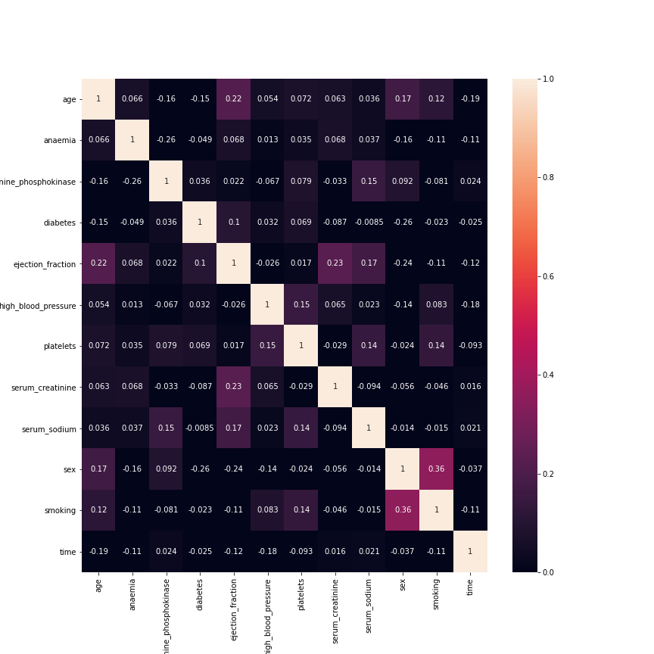
Identify Correlations
Ejection Fraction – Age
Ejection Fraction – Diabetes
Platelets – High Blood Pressure
Serum Creatine – Ejection Fraction
Serum Sodium – Creatine Phosphokinase
Serum Sodium – Ejection Fraction
Serum Sodium - Platelets
Sex – Age
Smoking – Age
Smoking – Sex
Smoking - Platelets
Figure 1: Correlation heat map of the people who died from heart failure

Slide 7
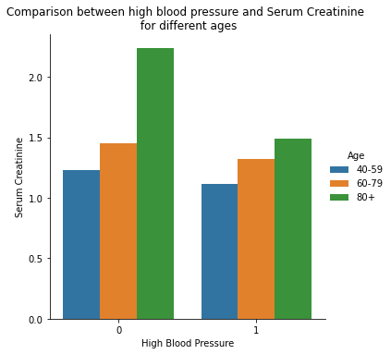
Findings!
As figure 2 suggests, serum creatine rises as you get older regardless of blood pressure
Is this an indicator of Heart Failure?
Figure 2: Serum Creatinine compared with High blood pressure

Slide 8
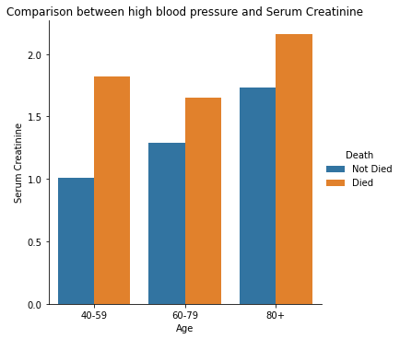
As figure 2 suggested the levels of creatinine steady increases with respect to age.
Serum Creatinine shows a deciding factor into heart failure for all ages.
A Hypothesis test could be carried forward to identify the significance of Serum Creatinine.
Figure 3: Serum Creatinine compared with Ages.

Slide 9
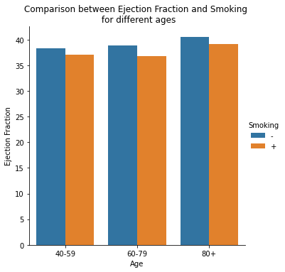
Figure 4 shows smoking having an impact on Ejection Fraction for all ages
However does Ejection factor contribute to heart failure?
Figure 4: Ejection Fraction compared with Ages by smokers.

Slide 10
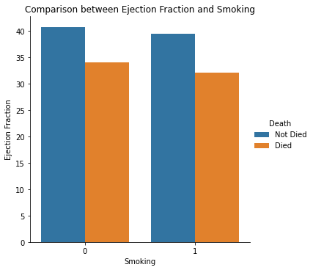
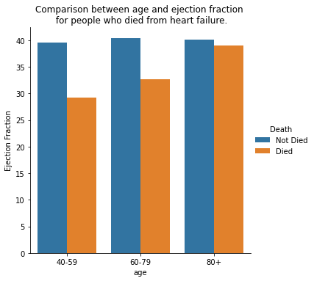
Figure 5 showing Ejection Fraction lower regardless if smoker.
Figure 5: Ejection Fraction compared with Smoking.
Figure 6 showing Ejection Fraction lower regardless if smoker.
Both graph shows a lower Ejection Fraction could contribute to heart failure
Figure 5: Ejection Fraction compared with Ages.

Slide 11
Take Away
31% of deaths resulting from cardiovascular disease
Trends are identifiable
High levels of Serum Creatinine could result to heart failure
A low Ejection Fraction could also result to heart failure
Next Step-
- Hypothesis testing on high levels of Serum Creatinine and low Ejection Fraction to identify the level of significance.

